Slide 1
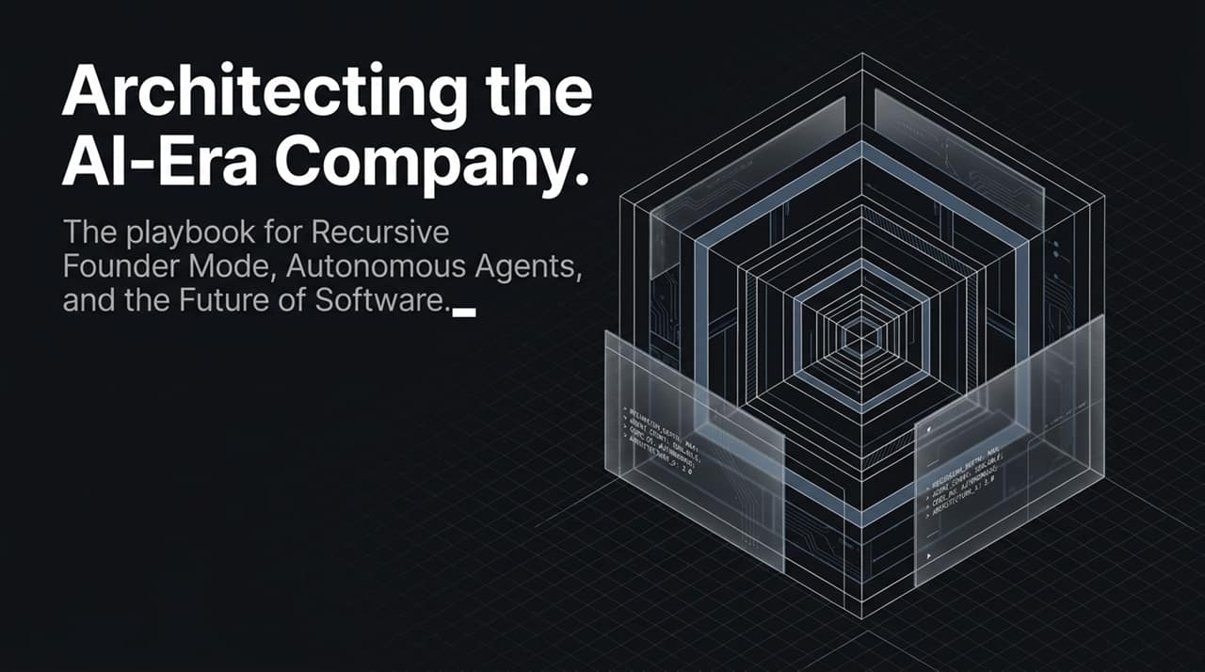
Notes:
Welcome, everyone. Today, we are discussing the playbook for building modern, high-velocity technology organizations. We call this framework The Recursive Enterprise. In this talk, we’ll explore how top-tier teams redefine organizational design using Recursive Founder Mode, autonomous AI agents, and a fundamental shift in how software is created and deployed. If you want to scale output non-linearly without drowning in corporate bureaucracy, this session sets the baseline.
https://www.youtube.com/watch?v=DdbCtAScTsk

Slide 2
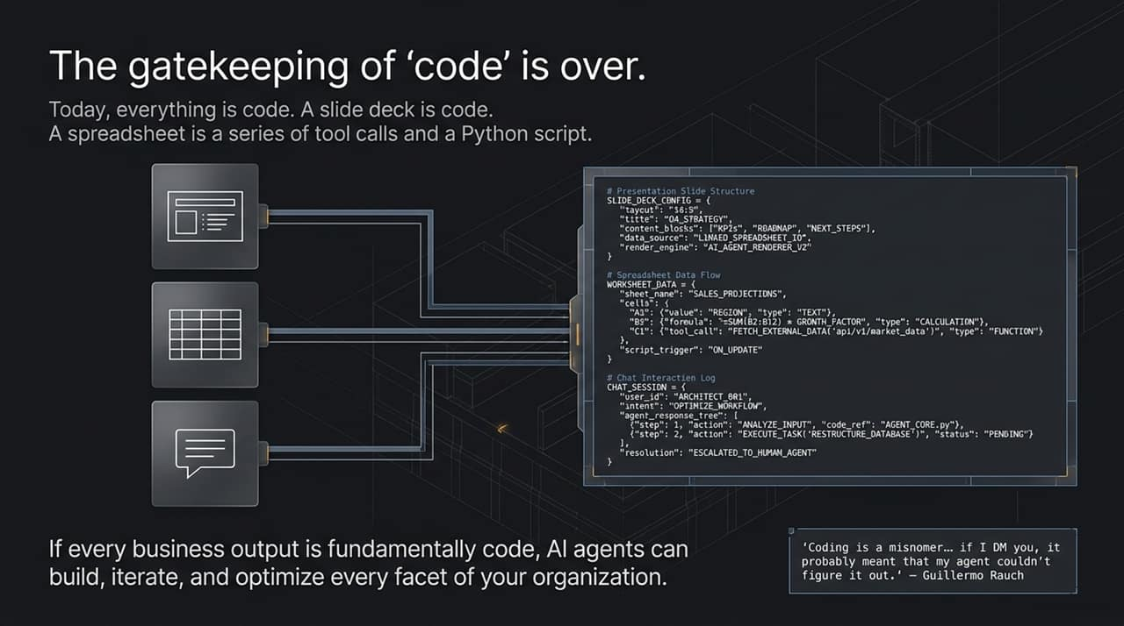
Notes:
We need to redefine our concept of software. The legacy barrier surrounding "code" has collapsed. Today, every artifact in your business—from slide decks defined in structured JSON to spreadsheets containing API tool calls and python scripts—is fundamentally code. When all business outputs are represented as code, AI agents gain the capability to read, build, iterate, and optimize every operational layer of your organization. As Guillermo Rauch famously noted, if someone sends a manual message or email, it usually indicates that an automated agent failed or hasn't been built yet.

Slide 3
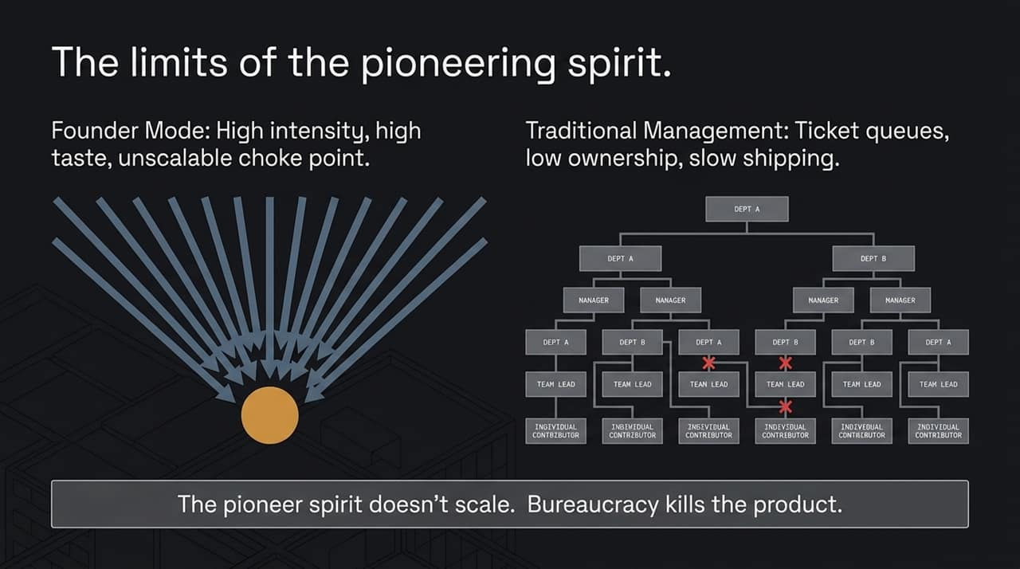
Notes:
Organizations typically hit two major operational walls as they grow. On the left, we see traditional "Founder Mode"—uncompromising quality and high intensity, but completely unscalable because every single decision flows through a single individual bottleneck. On the right, we see the traditional corporate pivot: middle management, ticket queues, and fragmented ownership where speed dies and product momentum halts. The pioneering spirit cannot scale centrally, yet traditional corporate bureaucracy destroys product quality.

Slide 4
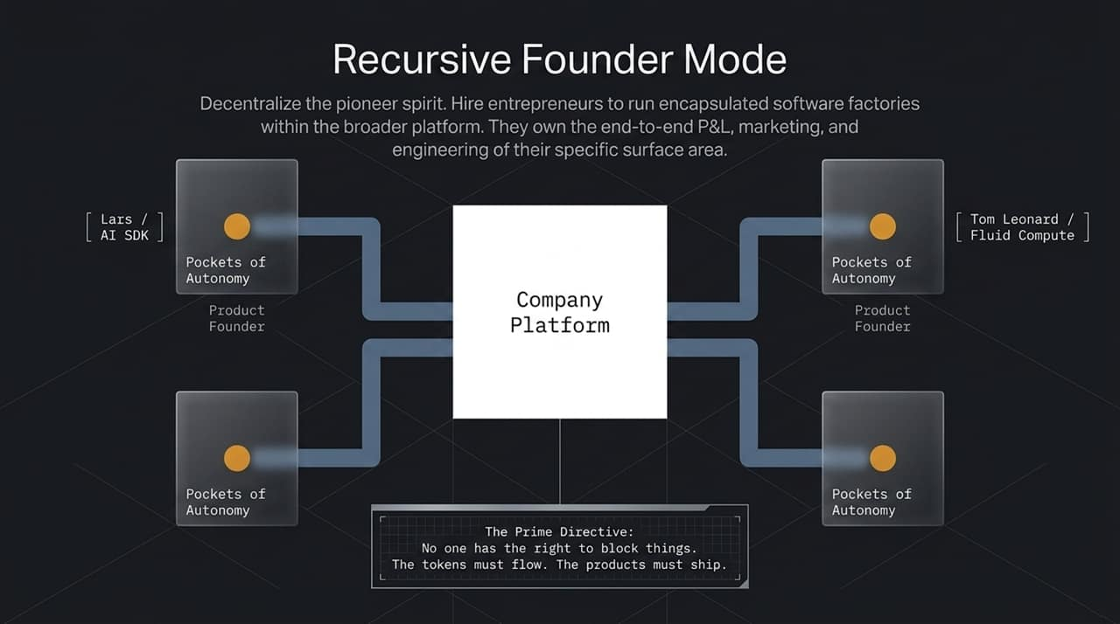
Notes:
The solution to scaling high-conviction execution is Recursive Founder Mode. Instead of relying on a single central founder or drowning in middle management, you decentralize the pioneer spirit. You hire high-agency entrepreneurs to manage encapsulated software factories operating directly on top of a shared central company platform. These product leaders exercise end-to-end P&L, engineering, and go-to-market ownership over their specific domain. The underlying governing rule—the Prime Directive—is simple: No one has the right to block progress; tokens must flow, and products must ship.

Slide 5
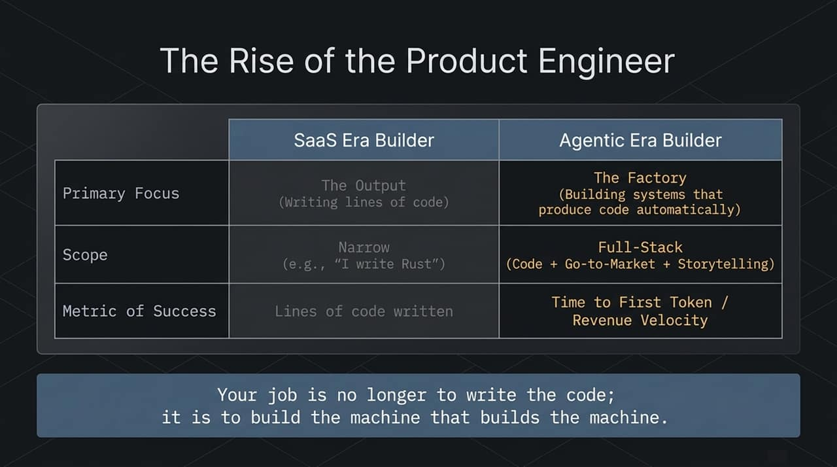
Notes:
This structural shift fundamentally changes the profile of the builder. In the SaaS era, engineers focused on writing raw lines of code to deliver specific features. In the Agentic era, the builder's primary focus shifts to The Factory—building meta-systems that produce code automatically through software agents. Scope expands to true full-stack ownership combining code execution, go-to-market strategies, and storytelling. Metrics for success move from static lines written to Time to First Token and raw revenue velocity. Your primary job is no longer to write code; it is to build the machine that builds the machine.

Slide 6
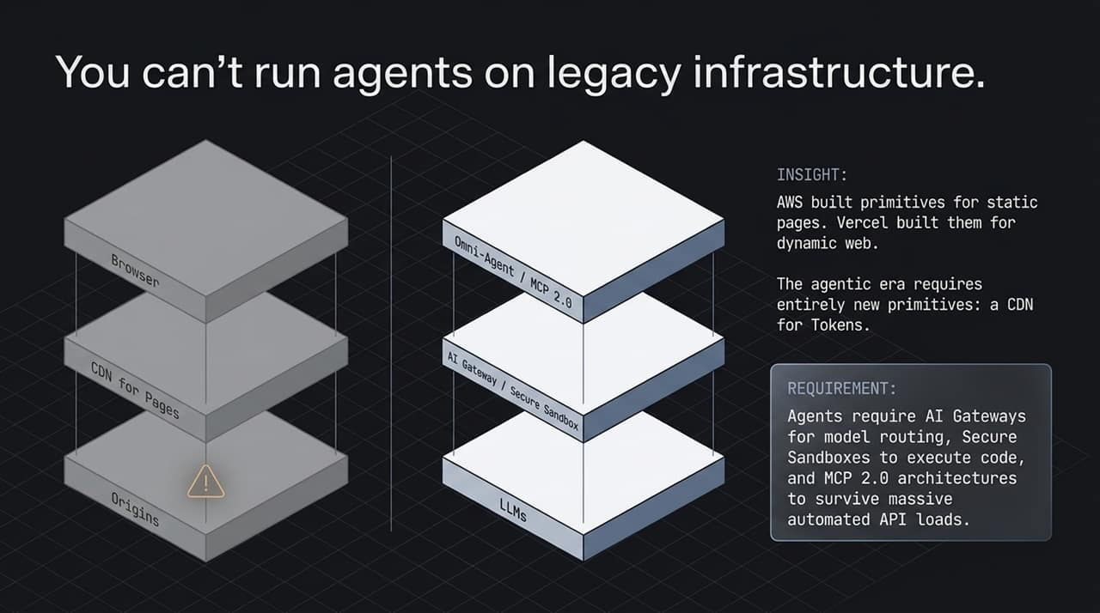
Notes:
Deploying dynamic AI agents on legacy cloud stack configurations creates major performance bottlenecks. Just as traditional cloud platforms created primitives for static web delivery, the agentic era requires an entirely new layer: effectively a CDN for Tokens. Autonomous agents require AI Gateways for intelligent model routing, secure sandbox environments to execute dynamically generated code, and MCP 2.0 (Model Context Protocol) architectures to manage massive, continuous API load demands without infrastructure failure.

Slide 7
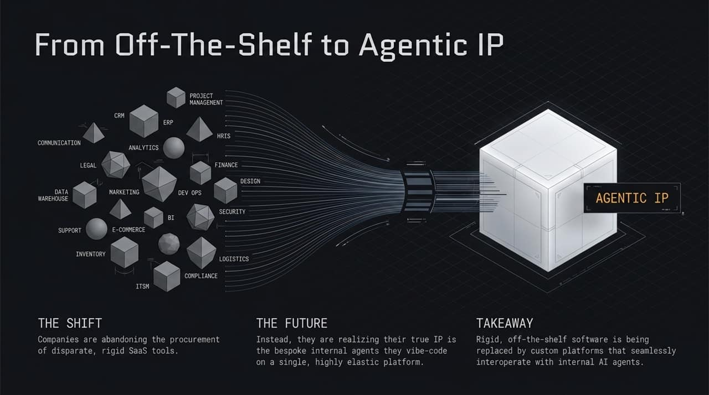
Notes:
We are witnessing a structural departure from traditional enterprise SaaS models. Modern enterprises are actively moving away from procuring dozens of disjointed, rigid off-the-shelf software subscriptions. Instead, organizations are consolidating their domain expertise into proprietary internal IP running on top of a unified, highly aligned platform. Commercial, off-the-shelf point solutions are rapidly being replaced by custom internal agentic systems that interoperate seamlessly with organizational data.

Slide 8
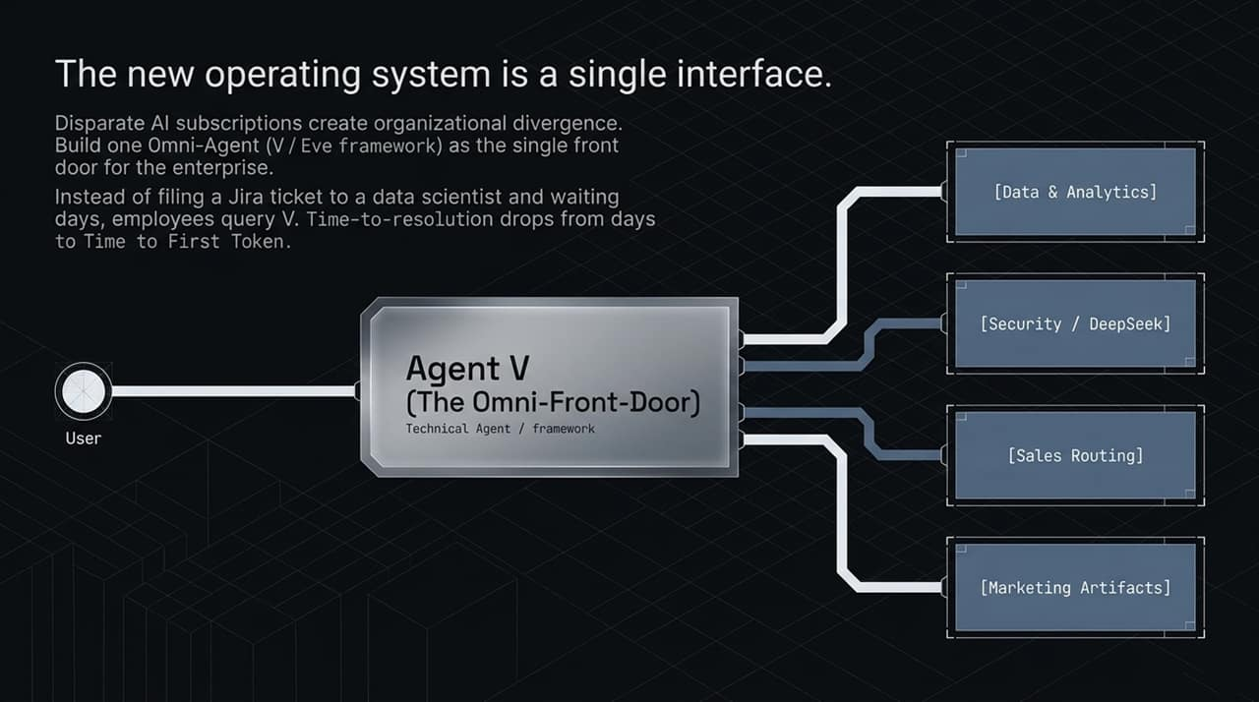
Notes:
Managing disparate AI tool subscriptions creates operational silos and fragmented internal knowledge. The modern enterprise unifies these systems through an Omni-Agent interface—such as "Agent V"—which acts as the single front door for all company operations. Instead of filing administrative tickets and waiting days for support, data science, or marketing tasks, employees query the central agent interface directly. Operational resolution time collapses from days to milliseconds.

Slide 9
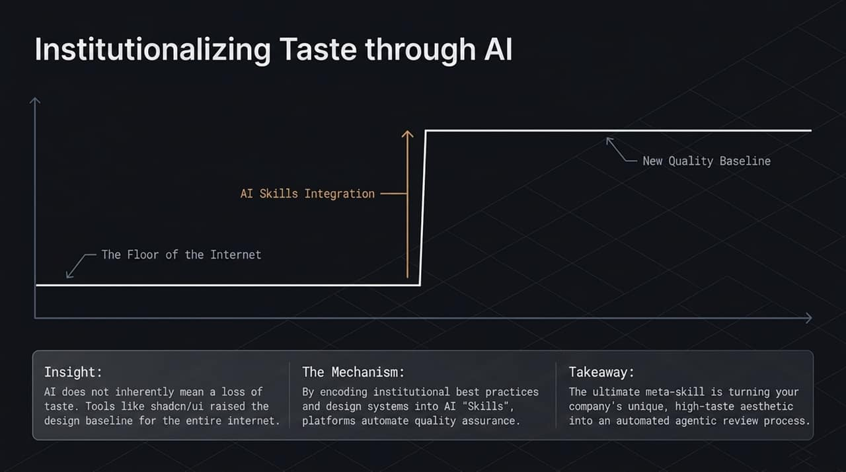
Notes:
A common concern is that automating execution leads to generic, low-quality outputs. In reality, proper agent implementation systematically elevates the quality baseline. By capturing institutional best practices, brand guidelines, and engineering standards directly into reusable AI "SKILLS" and review pipelines, platforms automate continuous quality assurance. Scaling your enterprise's distinct, high-taste standards into automated agentic review loops turns taste into reproducible software assets.

Slide 10
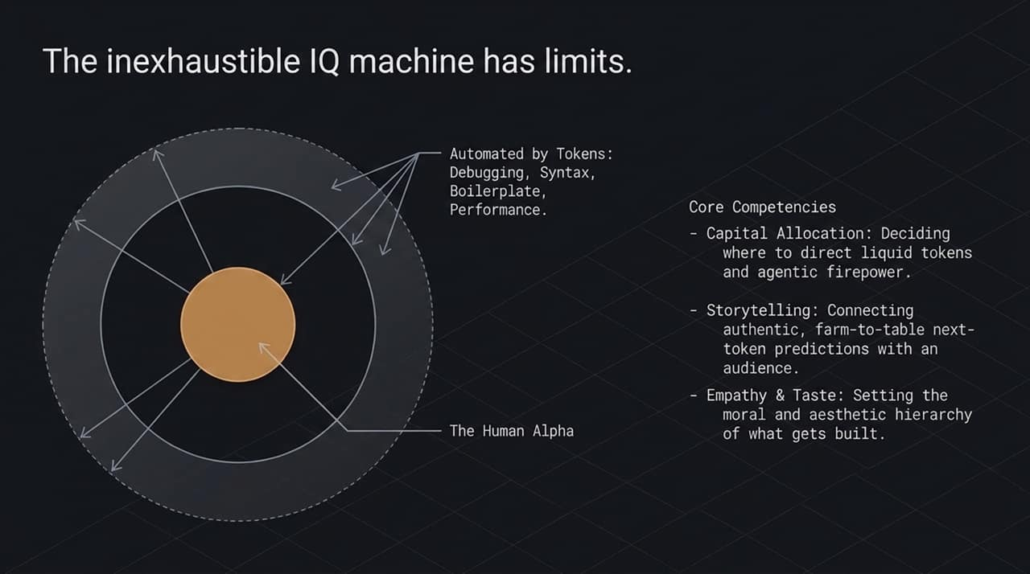
Notes:
While AI models provide effectively infinite processing speed for debugging, syntax generation, and routine boilerplate execution, human judgment remains the critical bottleneck. The true human alpha centers on three core competencies: strategic capital and compute allocation, authentic narrative storytelling, and maintaining deep empathy and aesthetic taste. As raw execution is automated by tokens, human effort concentrates on directing compute resources toward the highest-value outcomes.

Slide 11
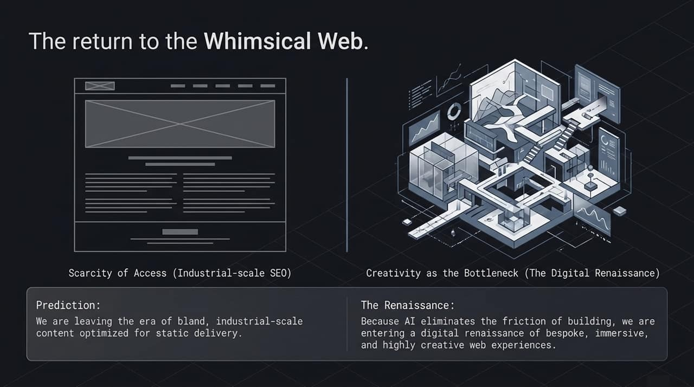
Notes:
Because AI drastically lowers the marginal cost of software development, we are moving away from corporate, standardized web templates built strictly for industrial SEO. Eliminating development friction triggers a digital renaissance. Web experiences are shifting back toward bespoke, highly dynamic, creative, and immersive digital environments designed specifically to engage real human users rather than search engine crawlers.

Slide 12
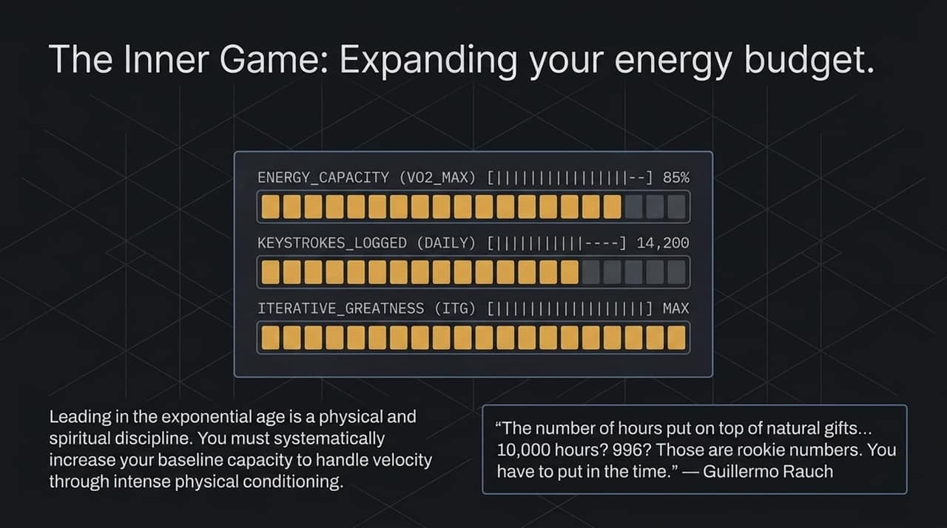
Notes:
Operating effectively in an exponential environment requires personal operational endurance. Leading high-velocity agentic systems demands physical and operational capacity to keep pace with rapid iteration cycles. As Guillermo Rauch emphasizes, sheer talent isn't enough; mastering high-speed execution requires sustained focus, intense physical discipline, and continuous, dedicated effort to manage high organizational velocity.

Slide 13
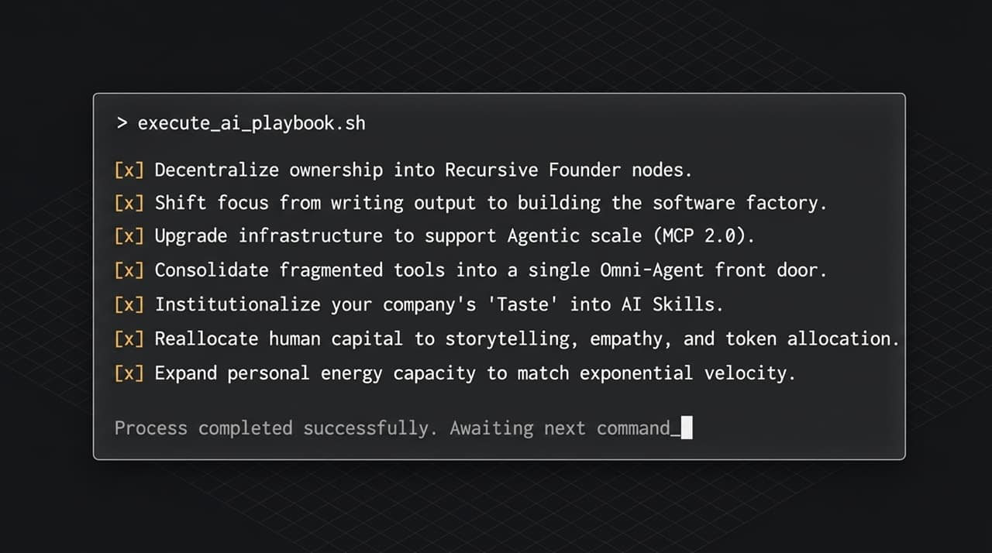
Notes:
To summarize our strategic blueprint: First, decentralize execution by empowering autonomous node leaders. Second, shift focus from manual output to building automated software factories. Third, modernize infrastructure to support token-based agentic workflows. Fourth, consolidate fragmented point tools into a unified agent front door. Fifth, encode company taste directly into AI skills. Sixth, reallocate human talent toward strategic allocation and storytelling. Finally, build the personal capacity required to operate at exponential velocity.

Slide 14
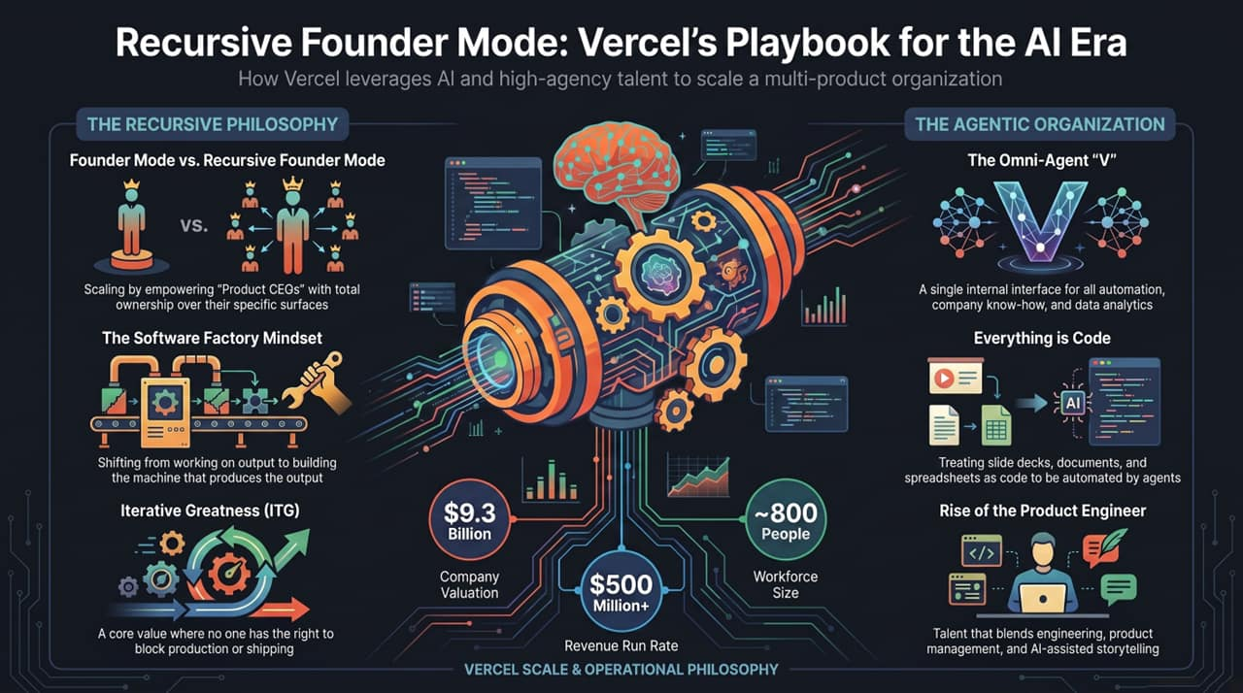
Notes:
This slide illustrates how these concepts come together in practice, using Vercel’s operational philosophy as a case study. By pairing Recursive Founder Mode with high-agency product owners, Vercel scales a $9.3B platform and $500M+ revenue run rate with a lean workforce of roughly 800 people.

